Slide 1


The AGS data format
bSI / OGC Geotechnical Data Standardization Workshop
Neil Chadwick, Geotechnical Engineer
Arup (London, England)
Member of the AGS Data Format Working Group

Slide 2
Introduction to AGS
UK ‘industry’ body, made up of…
GI contractors
Consultants (incl designers)
Some piling contractors
Some other specialists
Several ‘Working Groups’…
Business Practice
Loss Prevention
Safety
Contaminated land
Laboratories
Data Format
Geotechnical

Slide 3
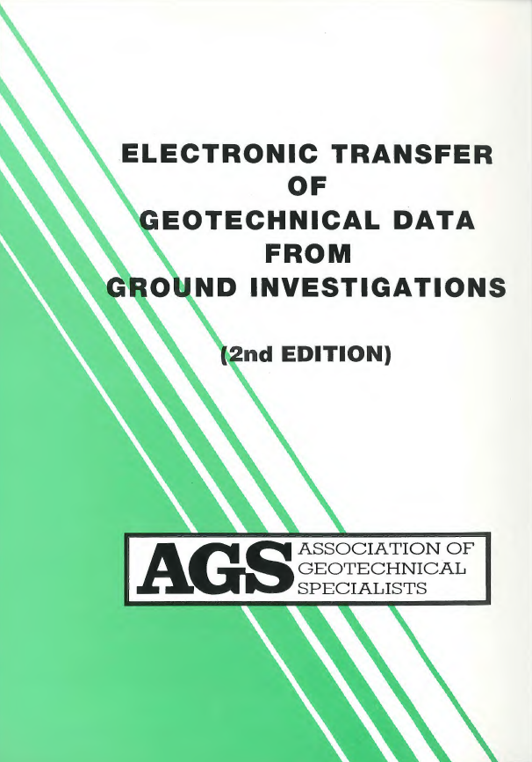
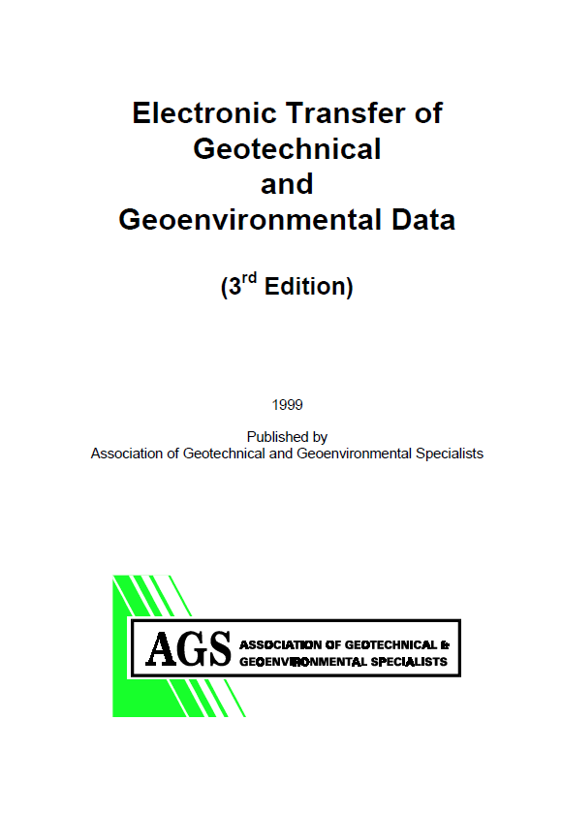
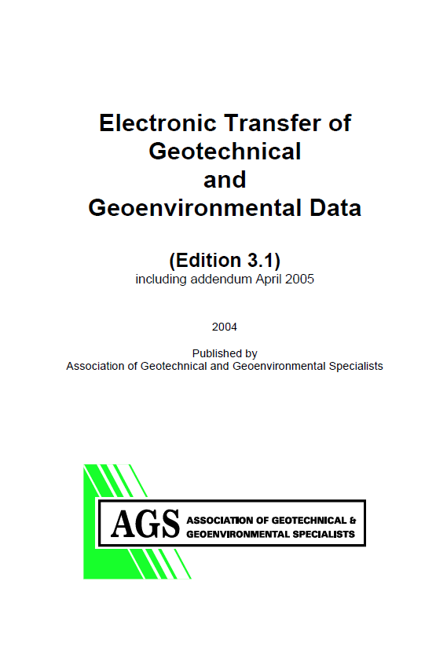
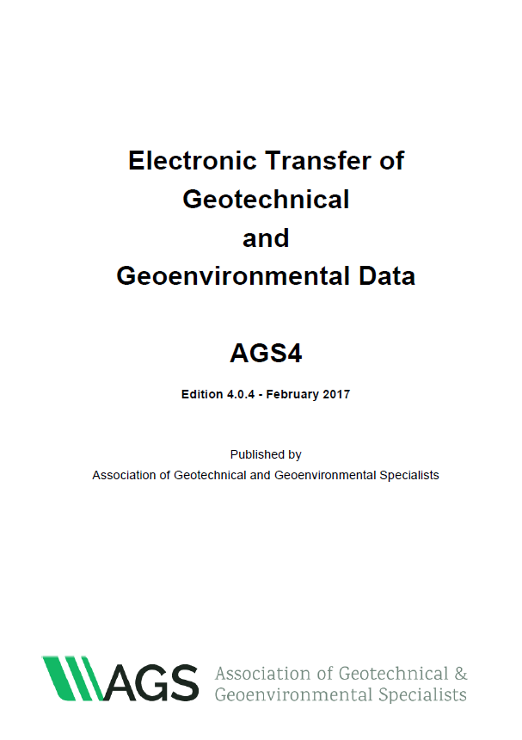
History of the AGS Data Format
1991 Working Group formed
v3.0
1999
v3.1
2004
v1.0
1992
v2.0
1994
v4.0
2011
Future?
Current:
v4.0.4

Slide 4
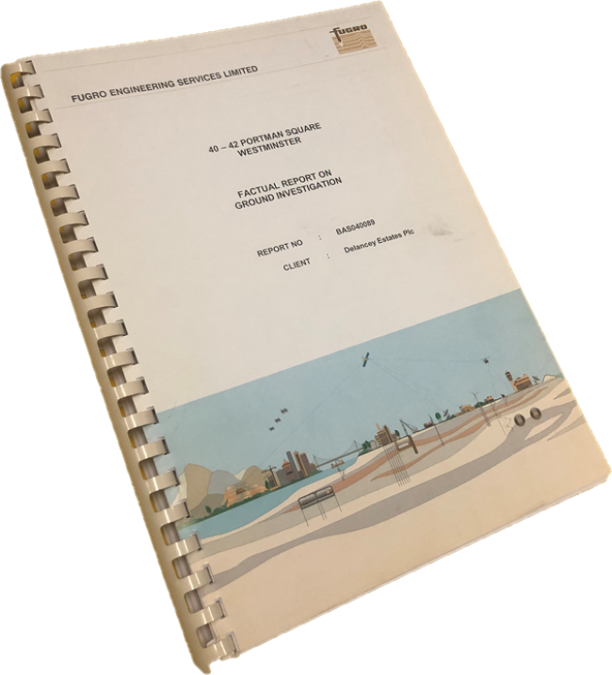
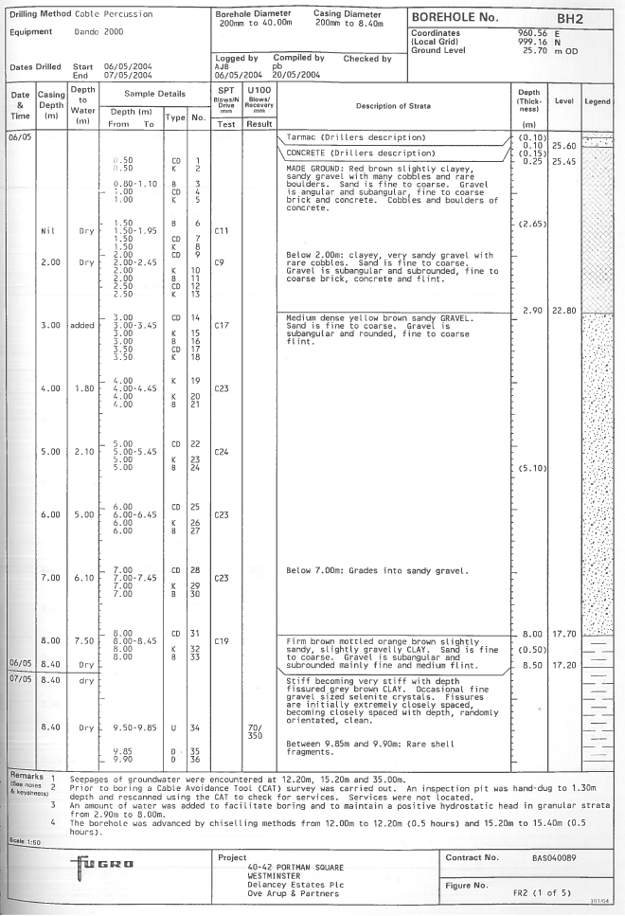
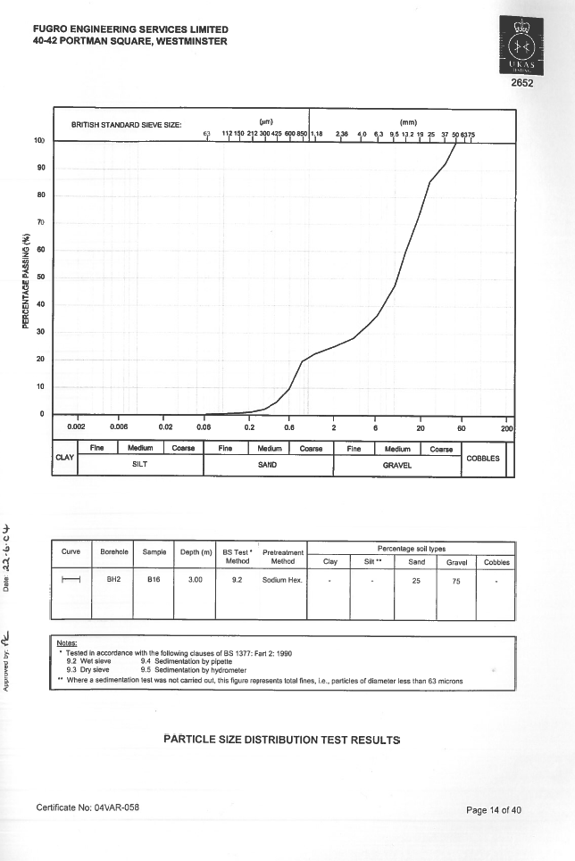


What is the AGS format? How is it used?
ASCII based format exchange of ‘factual’ ground investigation data
Does NOT (currently) include:
Interpreted/design data
Models
Construction data
GI Contractor
Designer
Contractors

Slide 5
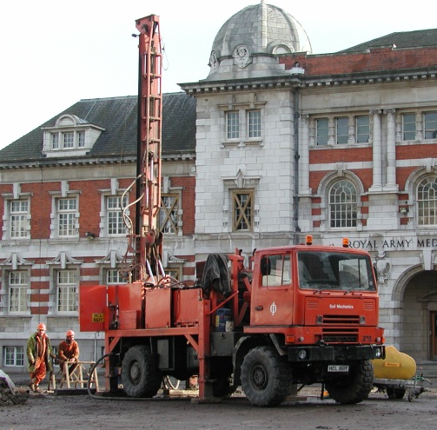
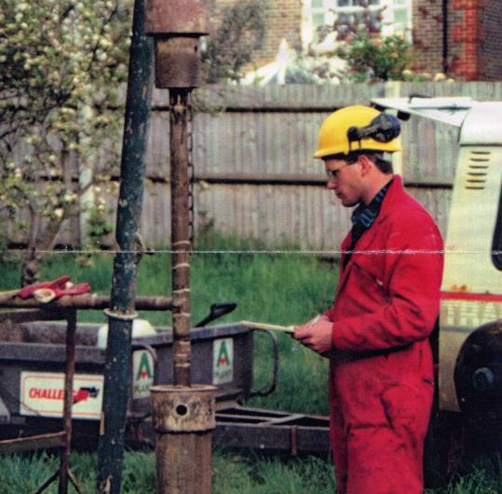
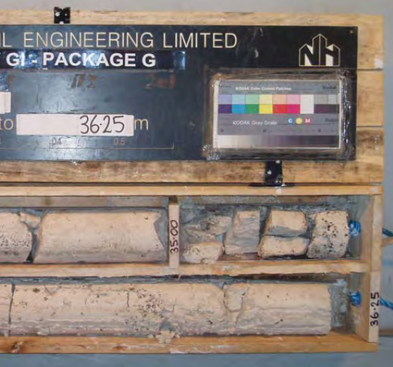
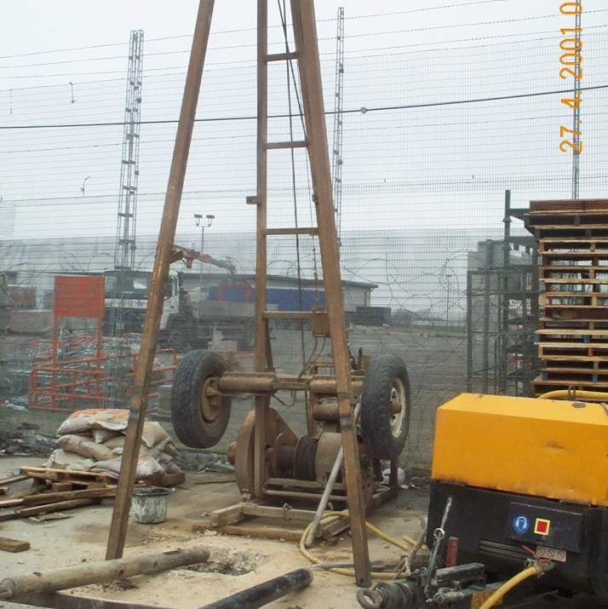
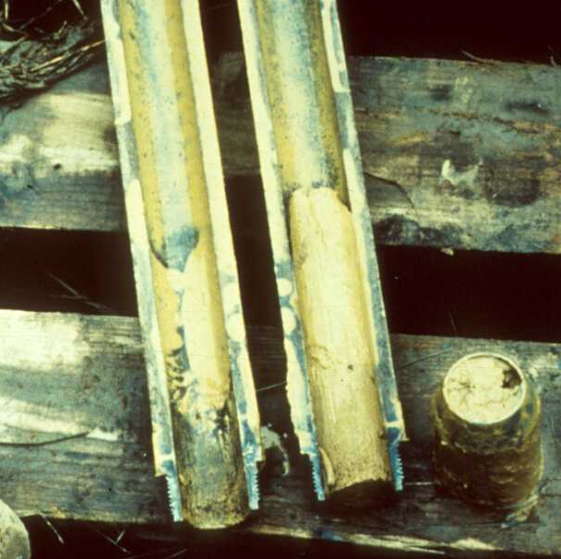
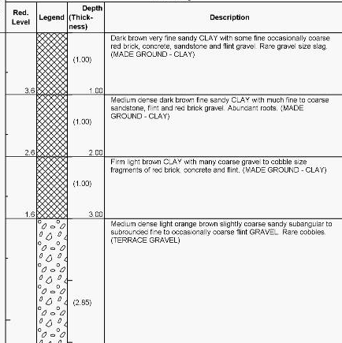
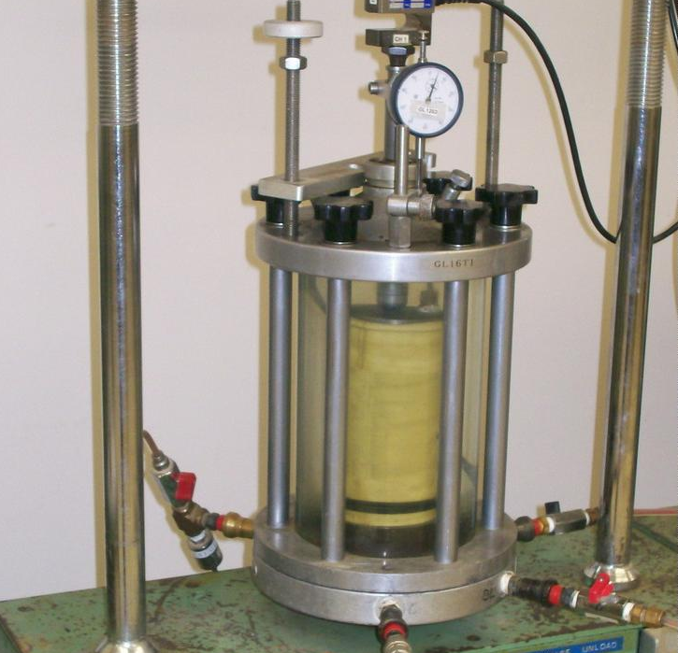
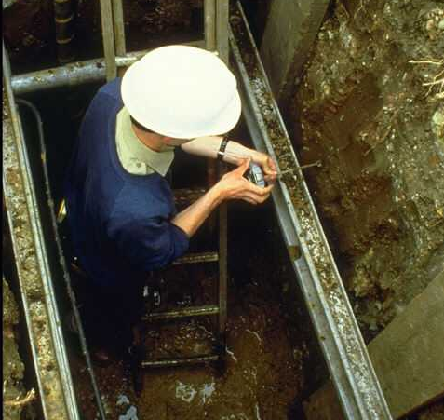
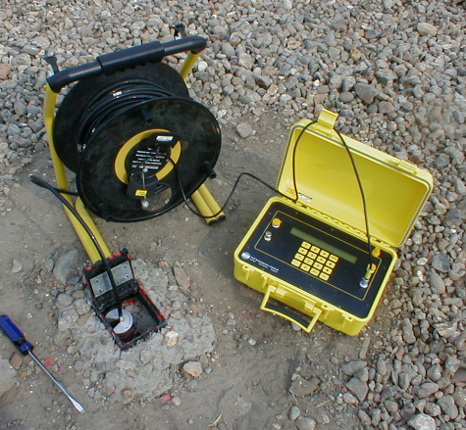
Scope of AGS format
Boreholes Trial pits & other types of exploratory hole |  | Sampling (geotechnical & contamination) |  | Geological descriptions Interpreted geology
 | SPT CPT & other in situ testing |  | Boring & drilling progress, records & observations |  | Installations Backfill
Contamination in situ & laboratory testing |  | Geotechnical, rock & aggregate laboratory testing |  | Piezometric monitoring Gas & other monitoring

Slide 6
AGS schema
Comprises:
Groups (= Tables)
and
Headings (= Fields)
In total…
124 ‘Groups’
2101 ‘Headings’

Slide 7
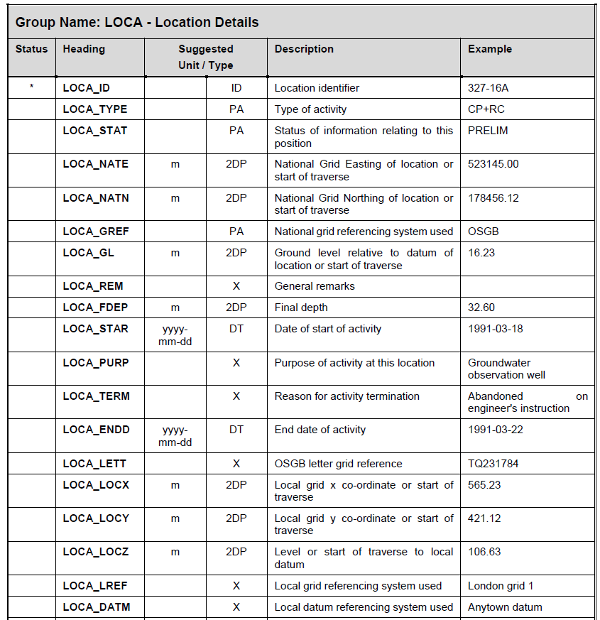
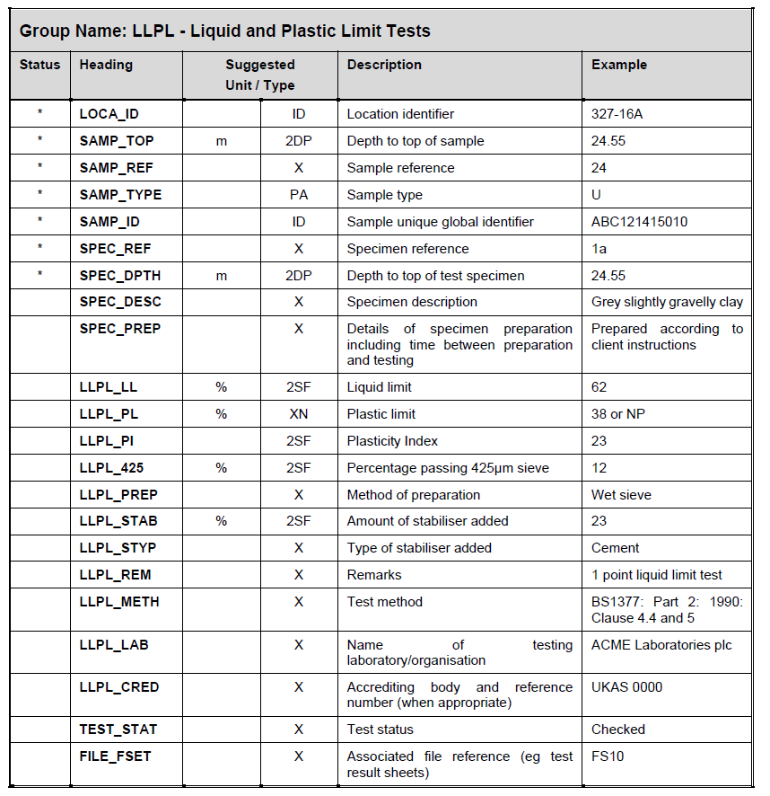
What is the schema: Data dictionary
From AGS maintained code list (recommended!) – but all codes used have to be included in ABBR Group
LOCA continues for a while…

Slide 8
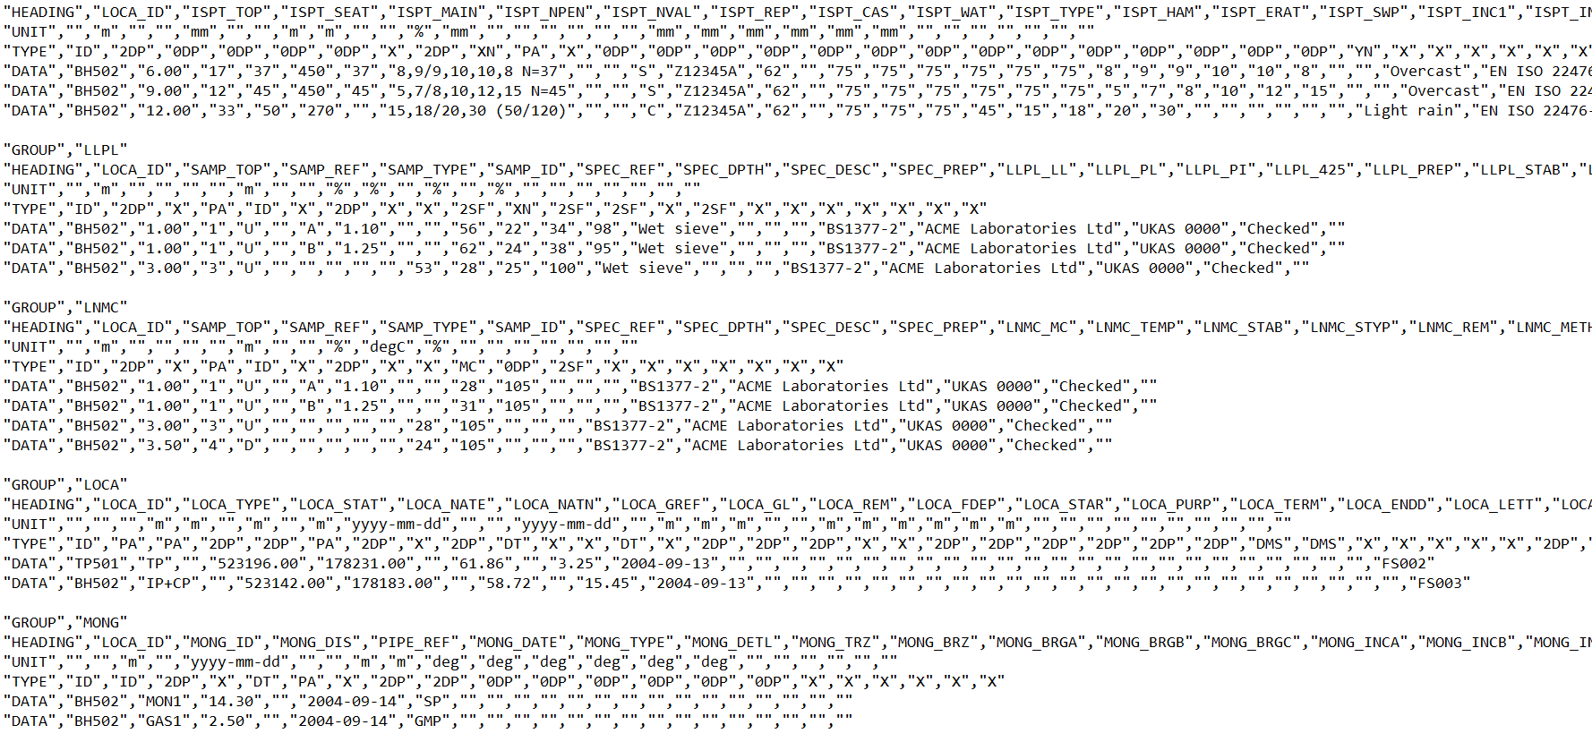
What does an AGS file look like?

Slide 9
AGS format future plans
AGS4 enhancements
Advanced lab testing
Wireline geophysics
AGS5 (end of 2019?)
Support JSON/other format output
but also looking at…
GI (hole) scheduling
Extend to include all factual report data (so AGS data can be primary deliverable)
Major extensions
Ground model and interpreted data (AGSi)
Piling
Grouting
Earthworks?

Slide 10
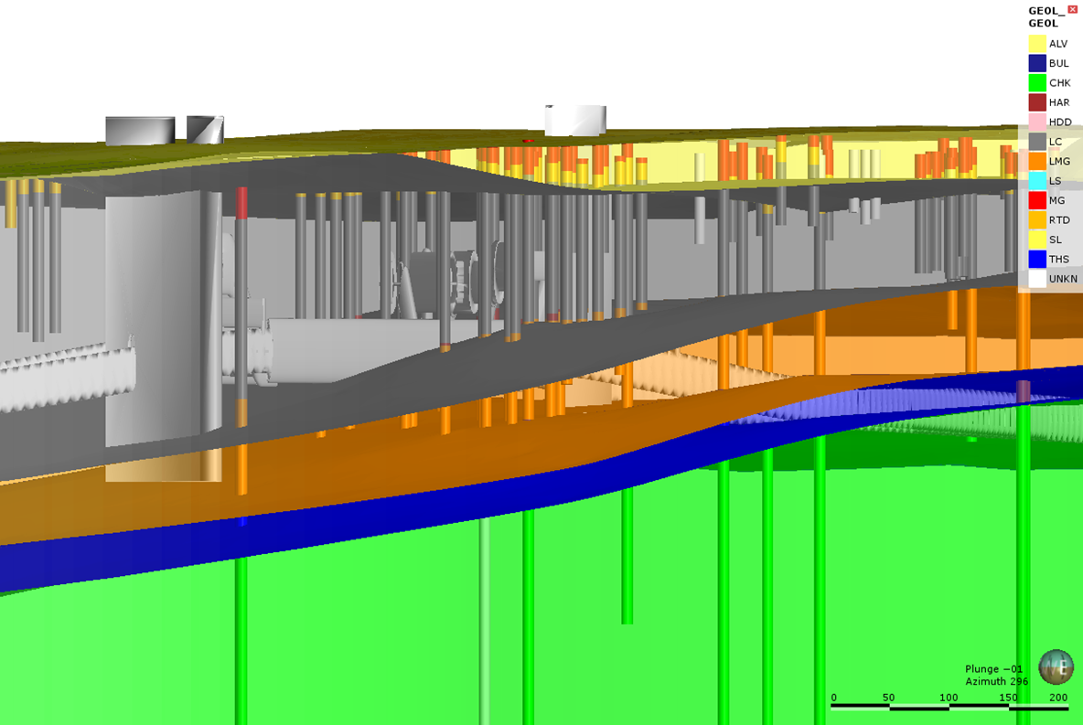
AGSi Extension for ground models and interpreted data
Scope (geometry):
3D volume models
from 2D surfaces
solid volumes
voxels
Borehole ‘sticks’
Fence diagrams (cross sections)

Slide 11
AGSi Extension for ground models and interpreted data
Scope (type of model):
‘Geological’ model (for interpretation and visualisation)
Design model (for automation and information)
... and we also plan to accommodate other types of ‘ground model’…
Earthworks classification
Rockhead
Groundwater
Contamination plume
etc.
MG
BUW = 18
Phi = 25
RTD
BUW = 20
Phi = 36
LC
BUW = 20
cu = 100 + 6z
LMG
BUW = 21
cu = 300

Slide 12
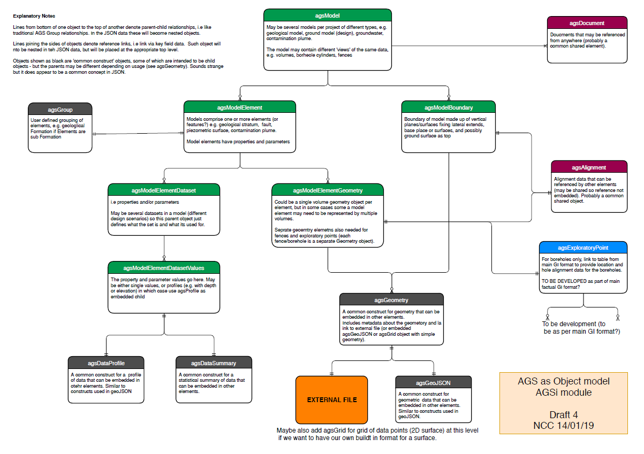
AGSi draft schema
Work in Progress
(current thoughts – it will change as we have identified some problems with this draft)
Object model
Optimised for JSON
Geometry – will allow links to external files
Work in progress

Slide 13
Final thoughts
A few observations…
There are many different types of ground model, and different types of geometrical representation.
Understand the difference between interpreted (geological) and design models
Ground investigation is more than just boreholes (pits, CPT, sampling, testing).
Factual data: Do you really want all of that ‘data’ in the models – or better to link out to compatible data (e.g. AGS, DIGGS, ????).
Understand the use cases!
AGS can bring its experience to the table:
factual data transfer format that works and is extensively used
lessons from development of AGSi
Desirable outcomes:
Formats developed by AGS, bSI OGC and others to be compatible, e.g. common conceptual model?
Agree a way forward towards adopting common terminology!
Thank you. For more information on AGS format: https://www.ags.org.uk/ (select ‘AGS Data Format’ on menu)

